Slide 1
CHƯƠNG TRÌNH ĐÀO TẠO NHÂN VIÊN
MÔN HỌC: CSS
SASS
Trình bày: Team Sass
HANOI – JUN, 2015
6/15/15
www.qsoftvietnam.com
1
Notes:
1

Slide 2

6/15/15
www.qsoftvietnam.com
2

Slide 3
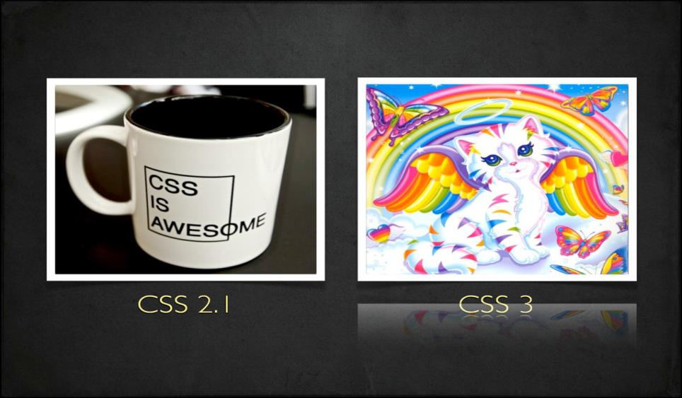
6/15/15
www.qsoftvietnam.com
3

Slide 4
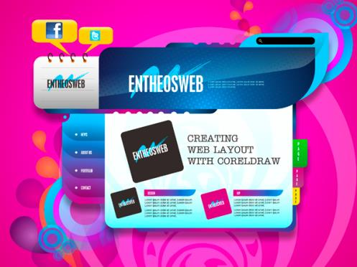
Good Speed
Work on my phone
Wow, 3D animation!
New Fonts
Multiple browser support
Colorful
Unbelievable
What they see
6/15/15
www.qsoftvietnam.com
4

Slide 5
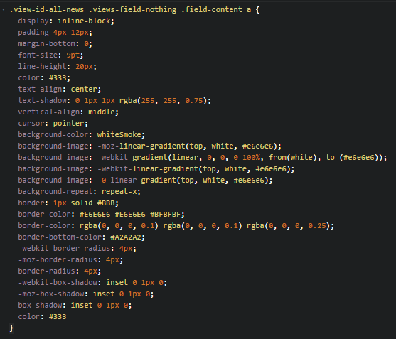

What we see
Too complex, too long
Difficult to maintain
What if customer want to change a color in project?
Ctrl + R => replace all?
6/15/15
www.qsoftvietnam.com
5

Slide 6
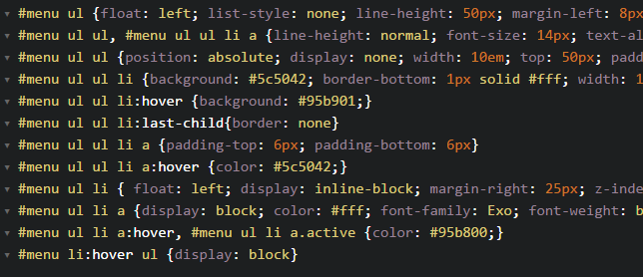
Dupplicate, hard to read
6/15/15
www.qsoftvietnam.com
6

Slide 7
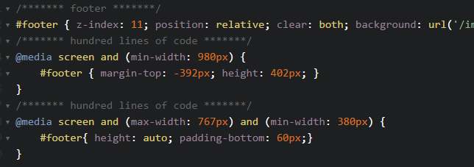
Waste of time
6/15/15
www.qsoftvietnam.com
7

Slide 8
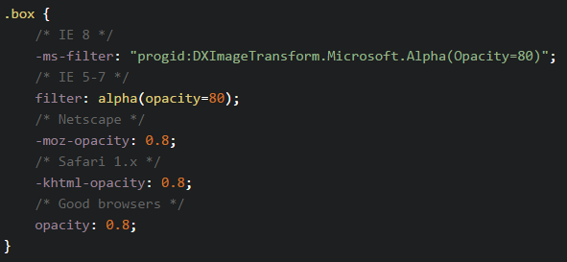
Hard to implement
6/15/15
www.qsoftvietnam.com
8

Slide 9
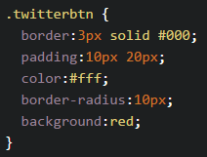
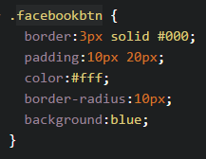


No re-use, just copy & paste
6/15/15
www.qsoftvietnam.com
9

Slide 10
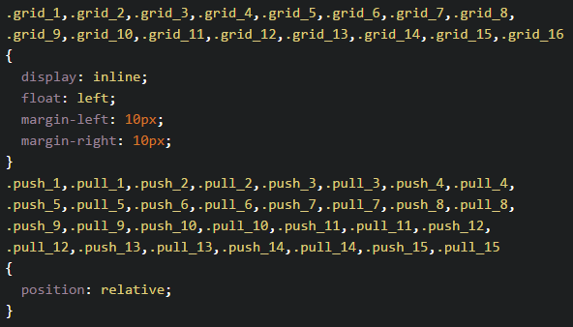
Oh my god, no looping function
6/15/15
www.qsoftvietnam.com
10

Slide 11
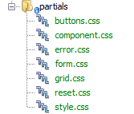
Separate CSS are good enough?
=> HTTP requests problem
6/15/15
www.qsoftvietnam.com
11

Slide 12
What we need?
Easy to change/maintain (Variable)
Easy to read (Nesting)
Easy to write (Mixins)
No duplicate, reusable code (Extend/Inheritance)
Easy to organize, fewer requests (Partials, Import)
Powerful (Operators, Condition, Loop)
6/15/15
www.qsoftvietnam.com
12

Slide 13

Introduction to
6/15/15
www.qsoftvietnam.com
13

Slide 14
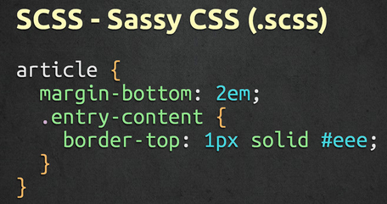
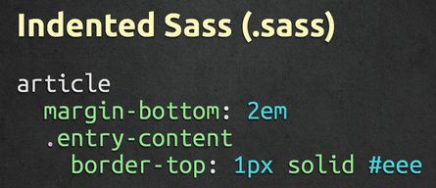
What is Sass
Syntactically Awesome StyleSheets
Simple but powerful syntax for creating manageable CSS
Too “flavors” – SASS & SCSS
6/15/15
www.qsoftvietnam.com
14

Slide 15
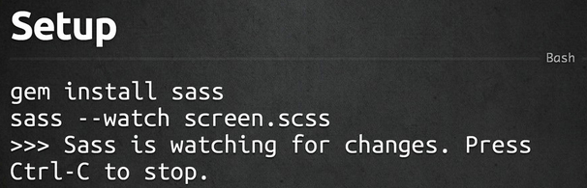
How to install
6/15/15
www.qsoftvietnam.com
15

Slide 16
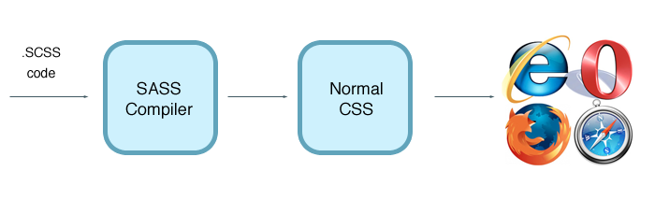
Sass work flow
6/15/15
www.qsoftvietnam.com
16

Slide 17

6/15/15
www.qsoftvietnam.com
17

Slide 18

6/15/15
www.qsoftvietnam.com
18

Slide 19
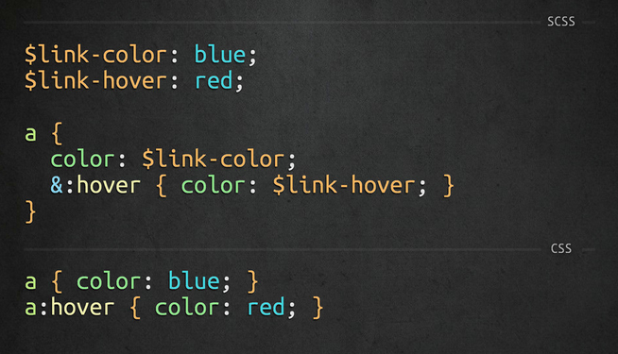
6/15/15
www.qsoftvietnam.com
19

Slide 20

6/15/15
www.qsoftvietnam.com
20

Slide 21
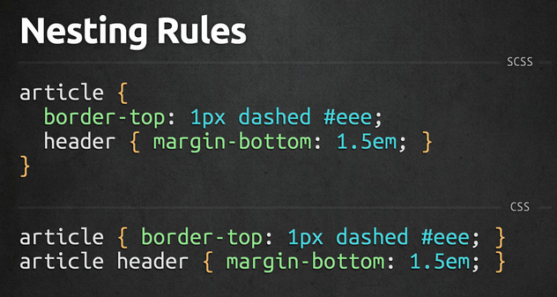
6/15/15
www.qsoftvietnam.com
21

Slide 22
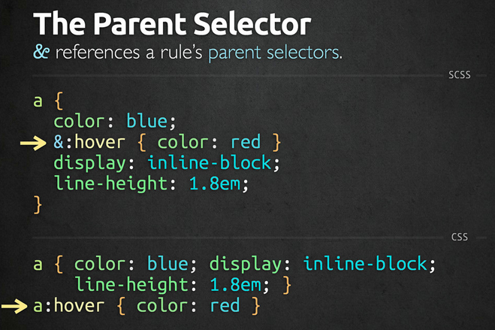
6/15/15
www.qsoftvietnam.com
22

Slide 23
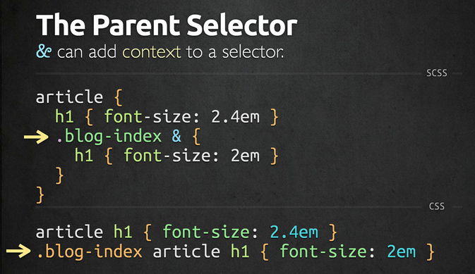
6/15/15
www.qsoftvietnam.com
23

Slide 24
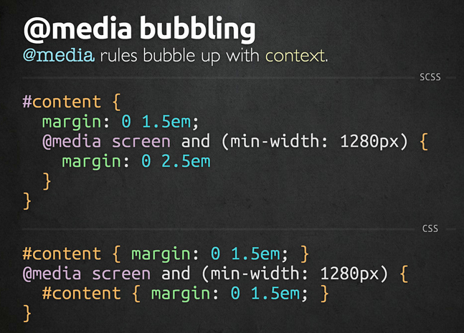
6/15/15
www.qsoftvietnam.com
24

Slide 25

6/15/15
www.qsoftvietnam.com
25

Slide 26
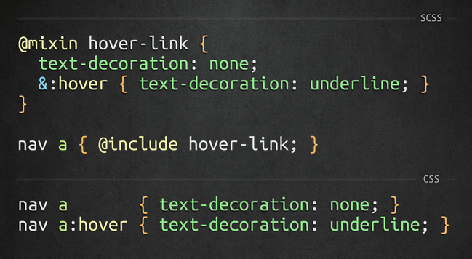
6/15/15
www.qsoftvietnam.com
26

Slide 27
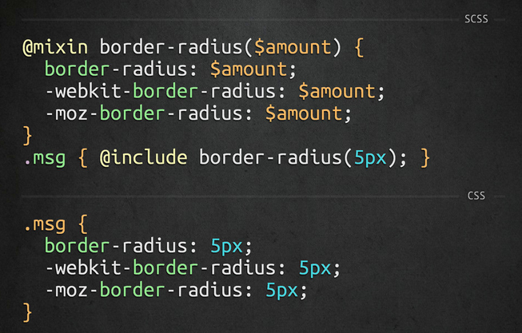
6/15/15
www.qsoftvietnam.com
27

Slide 28
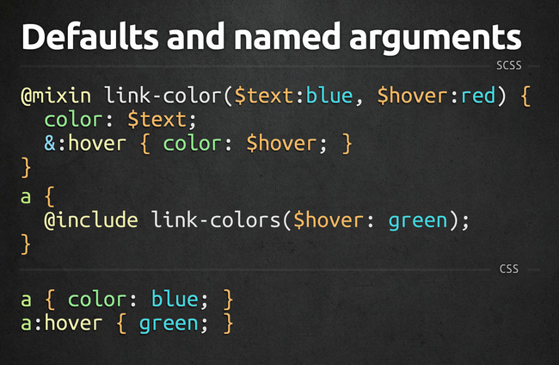
6/15/15
www.qsoftvietnam.com
28

Slide 29

6/15/15
www.qsoftvietnam.com
29

Slide 30
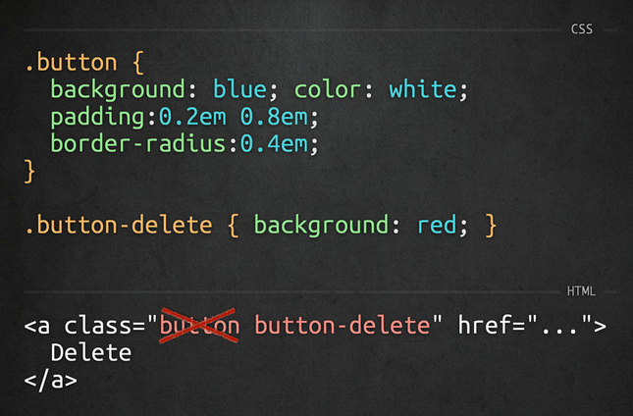
6/15/15
www.qsoftvietnam.com
30

Slide 31
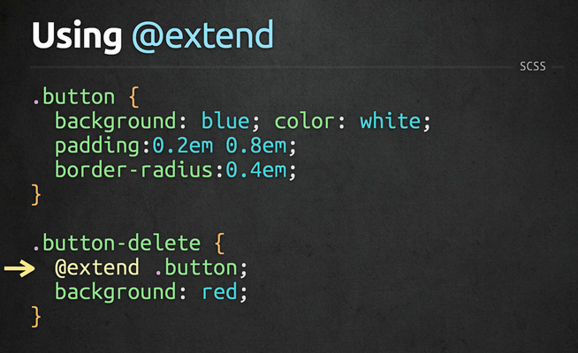
6/15/15
www.qsoftvietnam.com
31

Slide 32
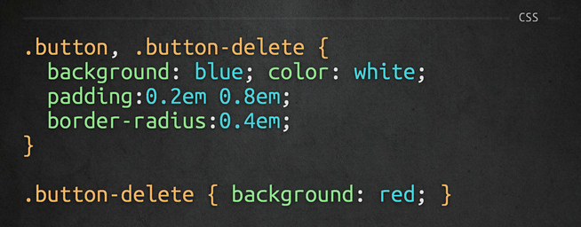
6/15/15
www.qsoftvietnam.com
32

Slide 33

6/15/15
www.qsoftvietnam.com
33

Slide 34
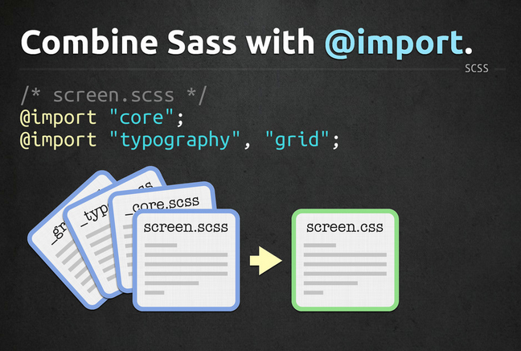
6/15/15
www.qsoftvietnam.com
34

Slide 35
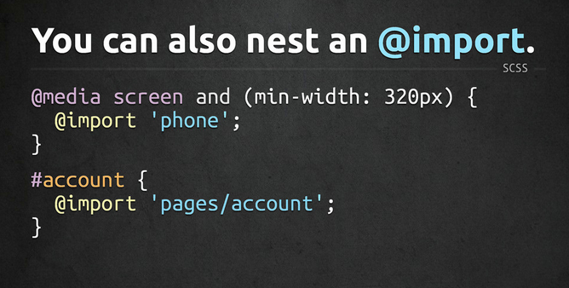
6/15/15
www.qsoftvietnam.com
35

Slide 36

6/15/15
www.qsoftvietnam.com
36

Slide 37
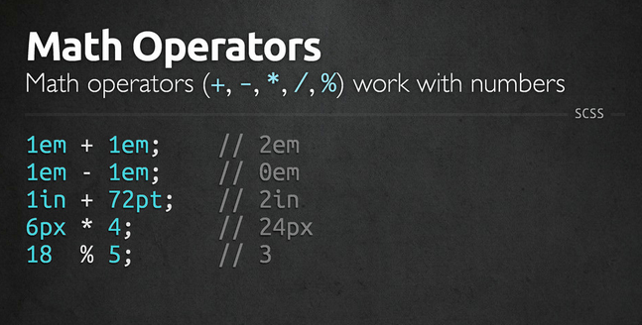
6/15/15
www.qsoftvietnam.com
37

Slide 38
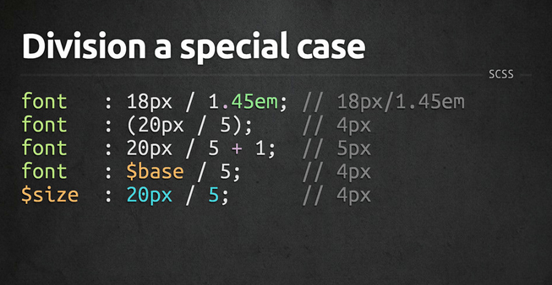
6/15/15
www.qsoftvietnam.com
38

Slide 39
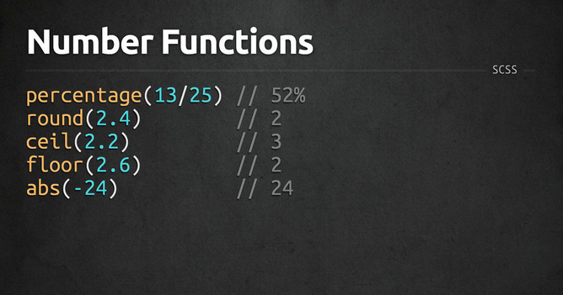
6/15/15
www.qsoftvietnam.com
39

Slide 40
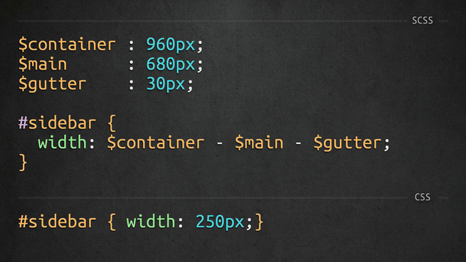
6/15/15
www.qsoftvietnam.com
40

Slide 41

6/15/15
www.qsoftvietnam.com
41

Slide 42

6/15/15
www.qsoftvietnam.com
42

Slide 43
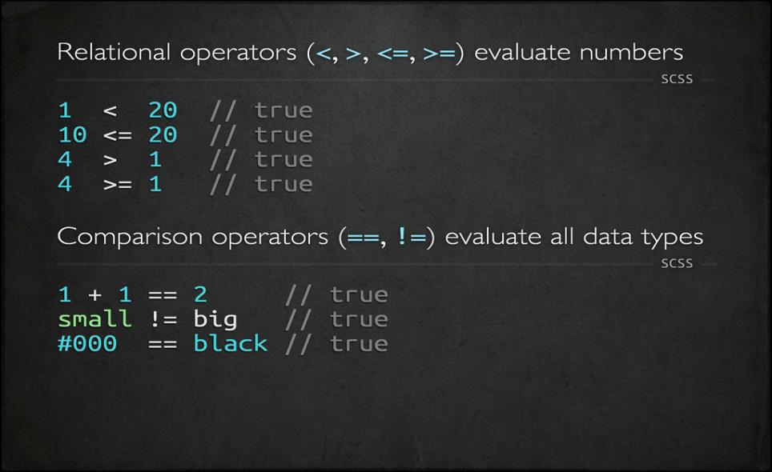
6/15/15
www.qsoftvietnam.com
43

Slide 44
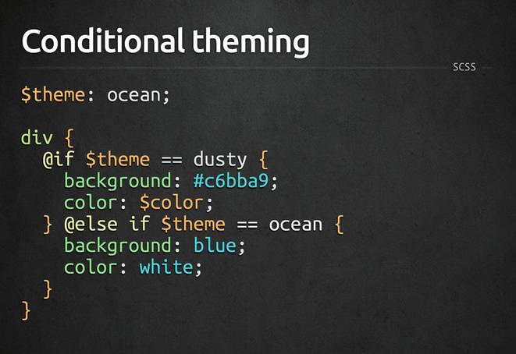
6/15/15
www.qsoftvietnam.com
44

Slide 45
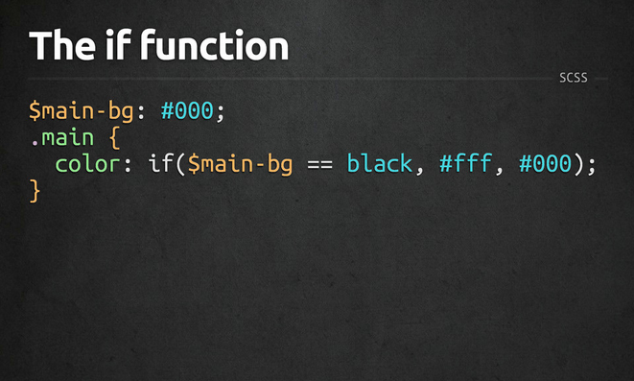
6/15/15
www.qsoftvietnam.com
45

Slide 46
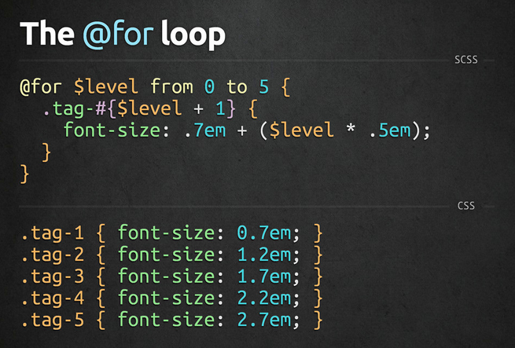
6/15/15
www.qsoftvietnam.com
46

Slide 47
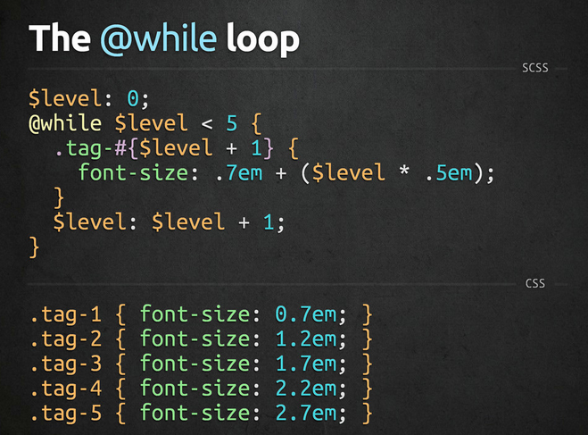
6/15/15
www.qsoftvietnam.com
47

Slide 48
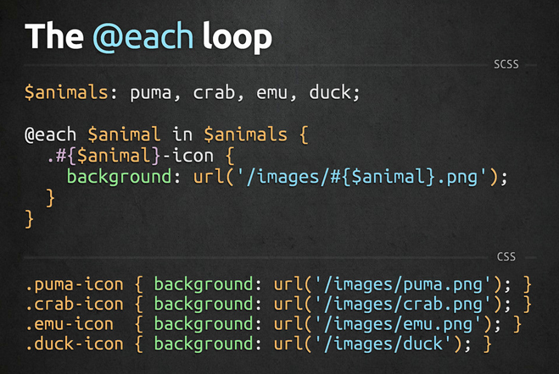
6/15/15
www.qsoftvietnam.com
48

Slide 49

6/15/15
www.qsoftvietnam.com
49

Slide 50
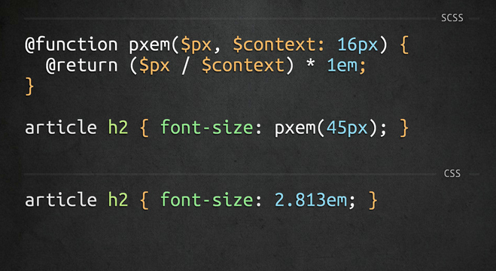
6/15/15
www.qsoftvietnam.com
50

Slide 51

Introduction to
6/15/15
www.qsoftvietnam.com
51
Notes:
http://compass-style.org/reference/compass/css3/
51

Slide 52
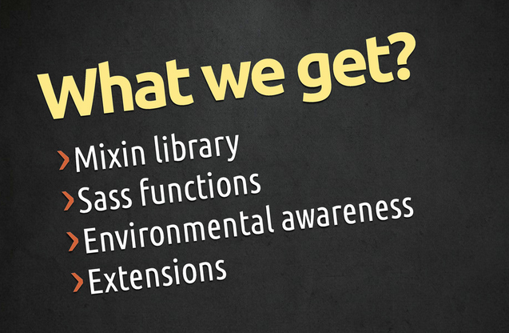
6/15/15
www.qsoftvietnam.com
52

Slide 53
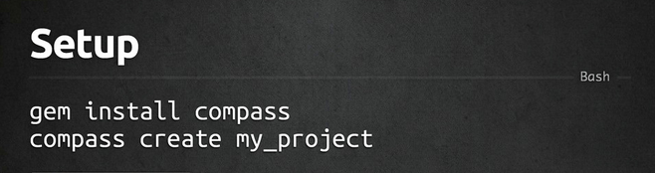
How to install
6/15/15
www.qsoftvietnam.com
53

Slide 54
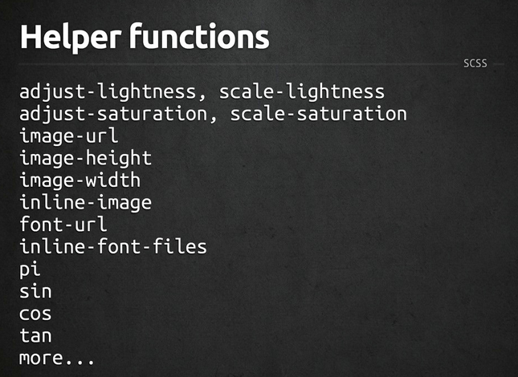
6/15/15
www.qsoftvietnam.com
54

Slide 55
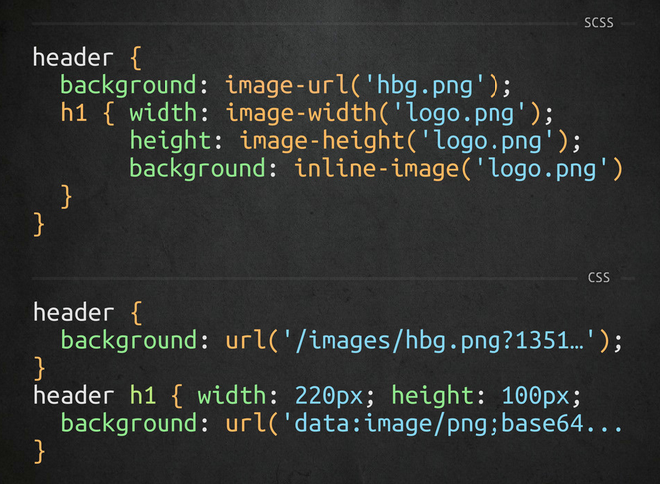
6/15/15
www.qsoftvietnam.com
55

Slide 56
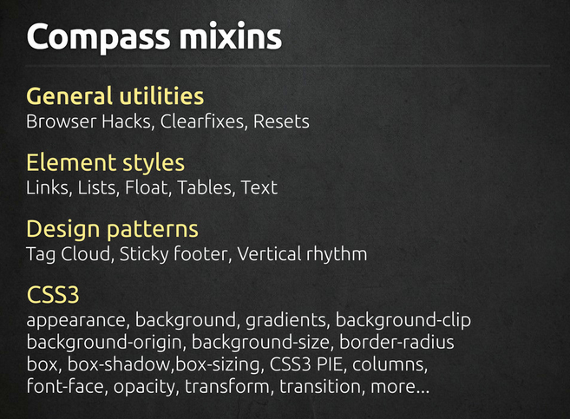
6/15/15
www.qsoftvietnam.com
56

Slide 57
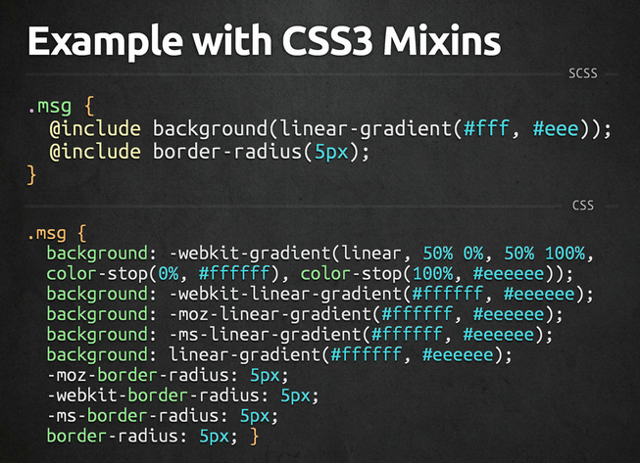
6/15/15
www.qsoftvietnam.com
57

Slide 58
Disadvantages
Not for beginners:
Need basic CSS, time to understand SASS
Need basic programming knowledge (problem for designer)
Need installation/environment setup
Need time to compile
A little bit hard to debug
Can’t edit on live server (nah, you shouldn’t do that)
6/15/15
www.qsoftvietnam.com
58

Slide 59
Sass Tools
Prepros
Livereload
Hammer
Koala
Scout
Bourbon
6/15/15
www.qsoftvietnam.com
59

Slide 60
Sass Tools
Compile SASS to CSS
Add mixins, functions, helpers
Add compass, autoPrefix, SourceMaps
Output style: Compressed, Compact, Nested, Expended
6/15/15
www.qsoftvietnam.com
60

Slide 61
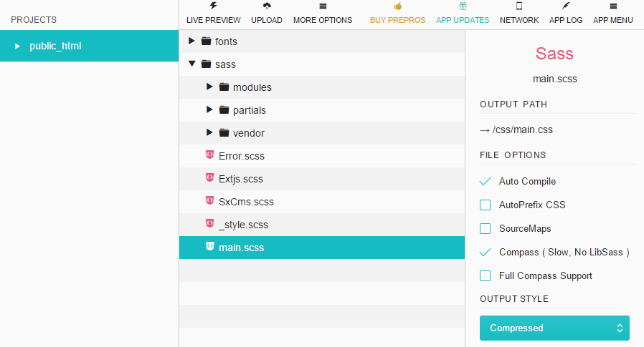
6/15/15
www.qsoftvietnam.com
61

Slide 62
THANK YOU FOR YOUR ATTENTION!
6/15/15
www.qsoftvietnam.com
62

